Slide 1
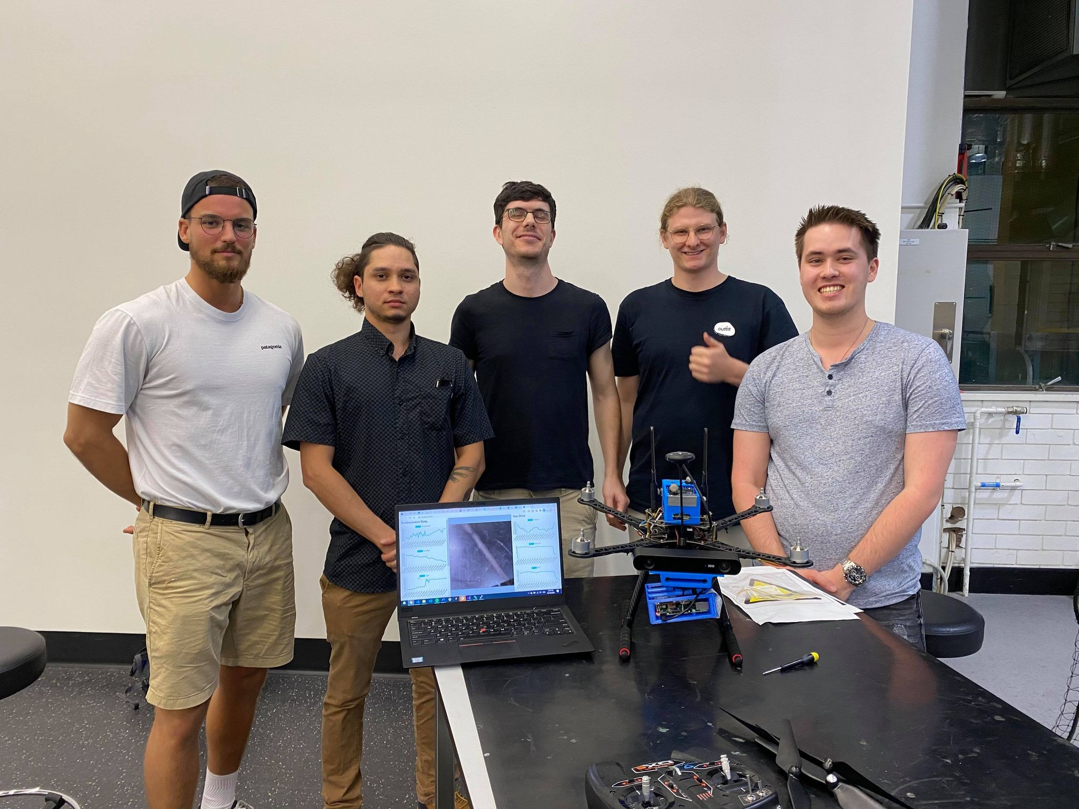
EGH455
Group 2
Alexander Iftene - Project Manager/Enclosure
Adrian Hiltunen - Sensor Data
James Arnold - Image Detection and Processing
Oliver Campbell - Image Detection and Processing
Brian Sivertsen - Web Visualisation

Slide 2
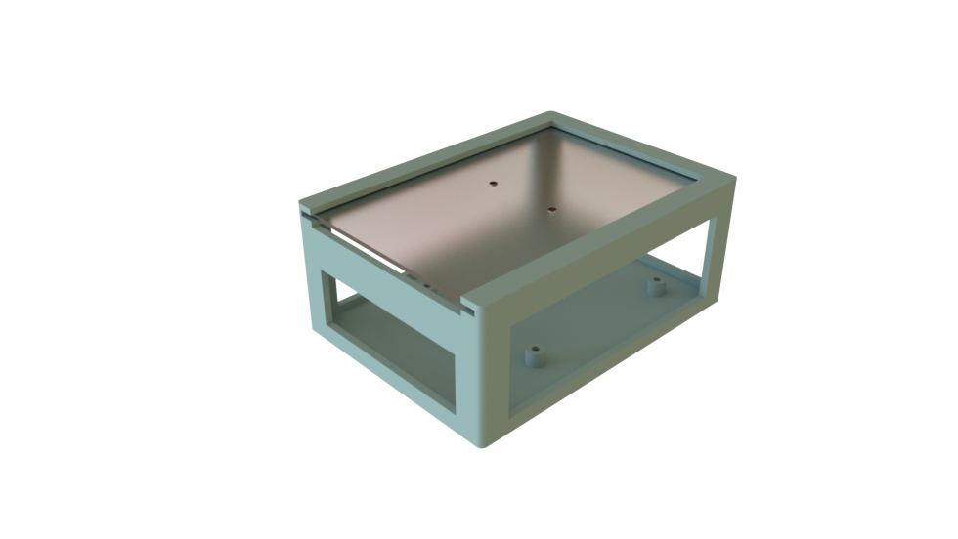
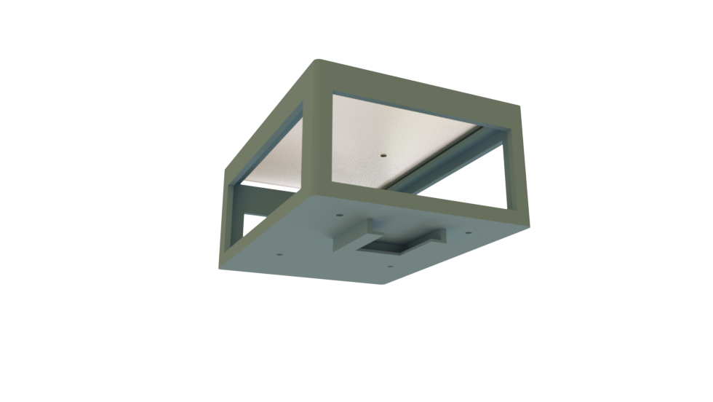
Alexander Iftene
Project Manager/Enclosure Design
Computer and Software Systems Engineering/Physics
Final year of study
Oversee team members responsibilities
and subsystems from a high level
system perspective, ensuring deadlines
are met.
Assist team members where required,
especially for dependent tasks.
Organise meetings (including booking
rooms and organising locations) and
maintain meeting minutes.
Design and create 3D printed container
to mount RPi and Camera to drone.
Manage budget (money, payload
weight, power, etc.).

Slide 3
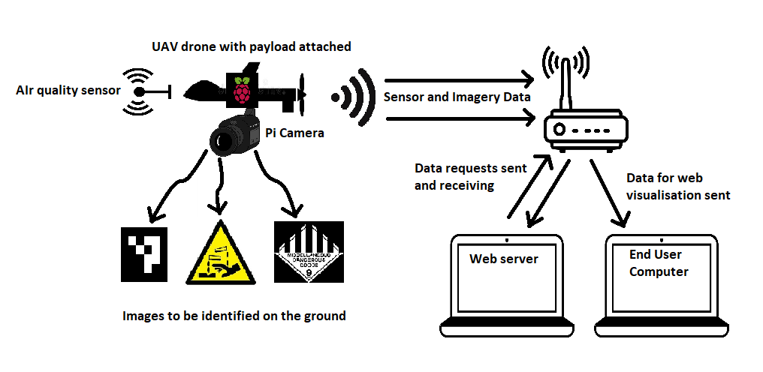
Introduction and Conops
REQ-M-01: Description: The UAVPayload^{TAQ} shall remain under the maximum weight of 250 g.
Rationale: The UAV that will carry the payload is required to remain under the maximum take-off weight of 2.2 kg.
REQ-M-03: Description: The UAVPayload^{TAQ} shall communicate with a ground station computer to transmit video, target detection and air quality data.
Rationale: The UAVPayload^{TAQ} is a standalone embedded system that should be adaptable to different UAV platforms.
REQ-M-8: Description: Preliminary designs shall be completed by week 7
Rationale: There are time constraints. In order to know what parts to purchase, the preliminary designs must be completed before week 7.
REQ-M-9: Description: Additional purchase orders for the UAVPayload^{TAQ} components shall be placed before week 7.
Rationale: There are time constraints. In order to start the build, the UAV parts must be ordered to allow time for delivery.
REQ-M-10: Description: Developed solution shall conform to the systems engineering approach.
Rationale: This is a requested requirement from the customer to ensure that the UAV is designed and built to a specific standard.

Slide 4
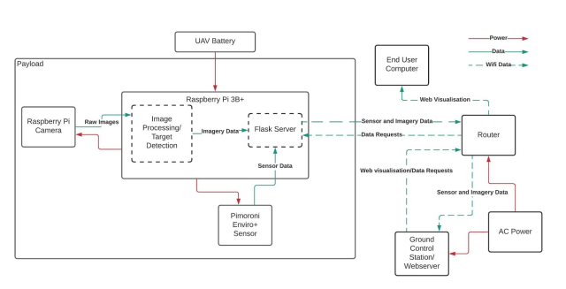
System Architecture

Slide 5
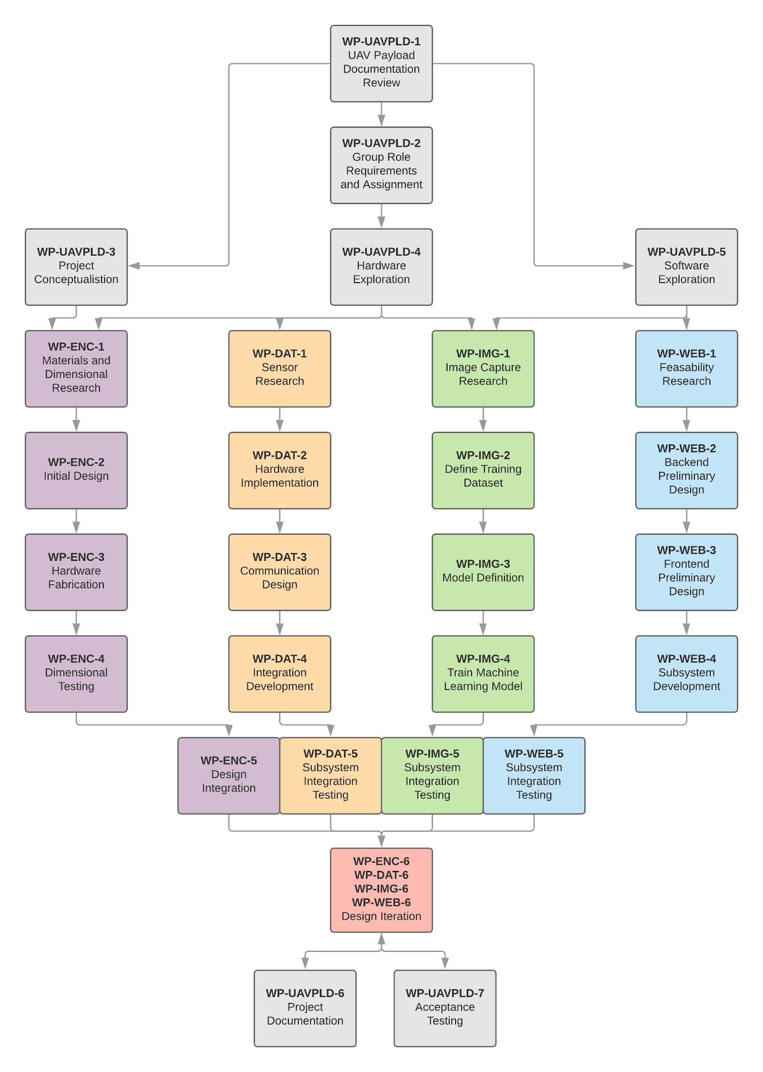
Work Breakdown Structure (WBS)
And Work Packets (WP)
Work Packets:
WP-UAVPLD: Work Packet for the UAV Payload Project Team
WP-ENC: Work Packet for the Enclosure subsystem
WP-DAT: Work Packet for the Data acquisition and sensoring subsystem
WP-IMG: Work Packet for the Image Processing subsystem
WP-WEB: Work Packet for the Web Visualisation subsystem

Slide 6
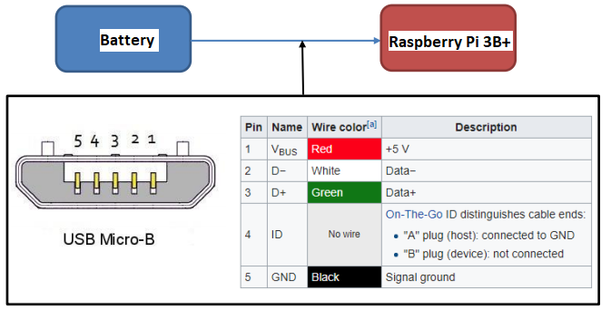
Interface Control Document (ICD) - Raspberry Pi 3B+
Interface is required to supply power from external rechargeable battery.
Minimum of 2 amps with 5V.
Supplied with Micro USB type B.
Pins 1 and 5 are utilised with VCC at 5V.

Slide 7
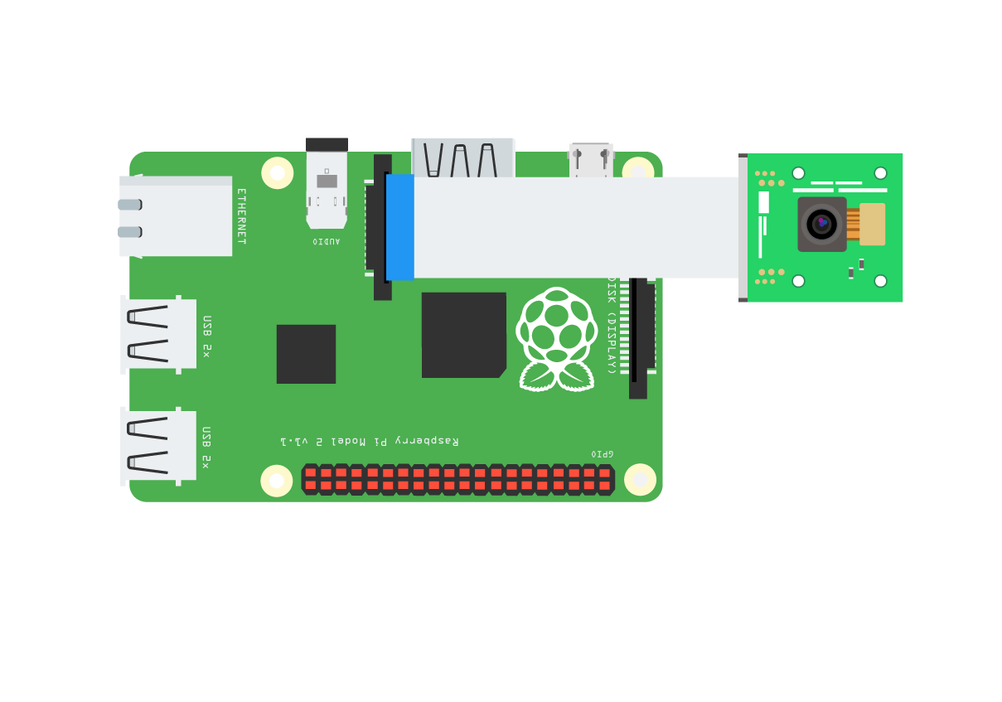
Interface Control Document (ICD) - Raspberry Pi Camera
Proprietary interface developed by Raspberry Pi.
Both power and data interface system.
Connector is a flat ribbon cable with push pin on both ends.

Slide 8
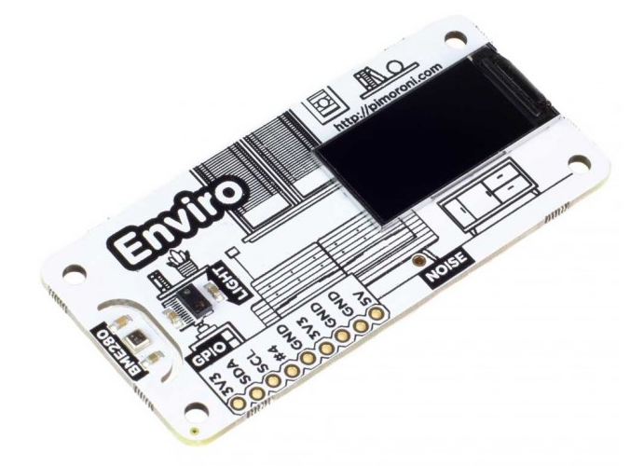
Interface Control Document (ICD) -
Pimoroni Enviro+ Sensor Hat
Interfaces power from the Raspberry Pi board.
Uses the male GPIO header from board to connect.
Powered by 5V VCC through male GPIO header.

Slide 9
Budget
Component | Value
Raspberry Pi 3B+ | 70
Rasbperry Pi 3B+ Case | 12.5
Rasbperry Pi 3B+ Power Supply | 18.95
Raspberry Pi Camera module | 38.95
Pimeroni Enviro+ Air Quality Sensor | 99.95
16GB Micro SD Card | 18.7
SD Card Reader | 20.95
Total | $280
Budget was quite low cost.
No components were broken/replaced during the development phase.
Budget was easy to manage and additional purchases were not necessary to complete project on time.

Slide 10
Timeline
Weeks 1 - 6 (Planning) | Weeks 6 - 8 (Implementation) | Weeks 8 - 10 (Testing) | Weeks 10 - 12 (Optimising)
Determining roles and responsibilities. | Web Visualisation system underway and being developed. | Testing of web system integration with sensory data and image data. | Tweaking all the subsystems so they operate optimally in flight with payload.
Designating workloads and objectives. | Sensory system underway and developing. | Checking to see if basic image processing requirements were met. | Printed final model of enclosure for payload.
Familiarizing with subsystems and customer requirements for the project. | Image Processing team developing system. | Sensory system debugging and integration. | Ensuring payload is within weight requirements of customer needs.
Developing PMP report for customer. | Designing of enclosure for payload underway. | Enclosure printing and re-printing. | Present and submit final PMP.

Slide 11
Adrian Hiltunen
Sensor Data Acquisition - Electrical & Software Systems - Final Year

Slide 12
Sensor Data Subsystem: Introduction & System Requirements
System Requirements
i. REQ-M-02/HLO-M-1: The UAV Payload device must measure and return readings of hazardous gases, air pressure, humidity, temperature, light, and noise levels via sensors onboard the device.
ii. REQ-M-03, HLO-M-1: The UAV Payload must communicate wirelessly to a GCS via a standalone embedded system.
iii. REQ-M-05, HLO-M-3: Real time air sampling data must be recorded and dynamically updated throughout the UAV’s flight through a Web Interface.
Work Packets
WP-DAT-1: Sensor Research
WP-DAT-2: Hardware Implementation
WP-DAT-3: Communication Design
WP-DAT-4: Integration Development
WP-DAT-5: Integration Testing

Slide 13
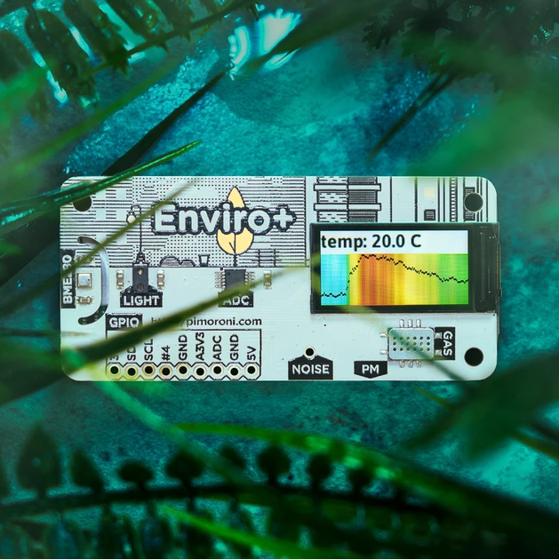
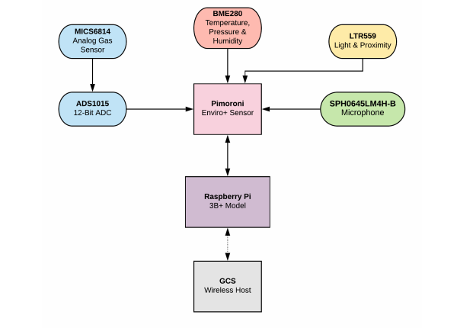
Sensor Data Subsystem: Architecture
Image courtesy of Pimoroni: https://shop.pimoroni.com/products/enviro?variant=31155658457171

Slide 14
Sensor Data Subsystem: Design
Hardware:
Pimoroni Enviro+ Sensor Hat for Raspberry Pi
All-in-one solution
Provided by design brief
Datasheet compilation & investigation
Software:
Primary foundation sourced from existing driver library
Scripted modules written in Python
Additional data formatting required

Slide 15
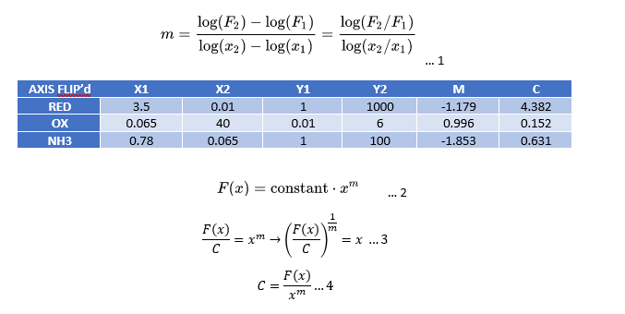
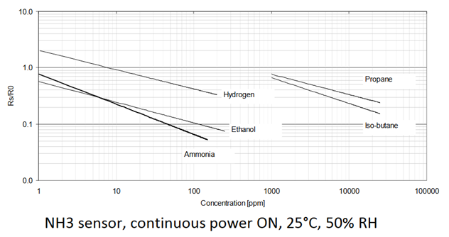
Sensor Data Subsystem: Design

Slide 16
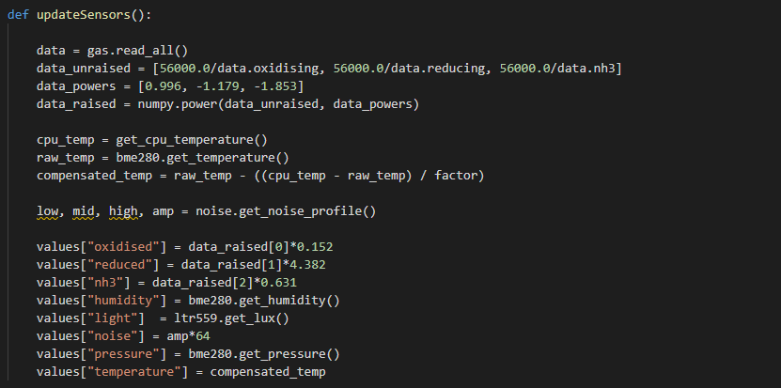
Sensor Data Subsystem: Design

Slide 17
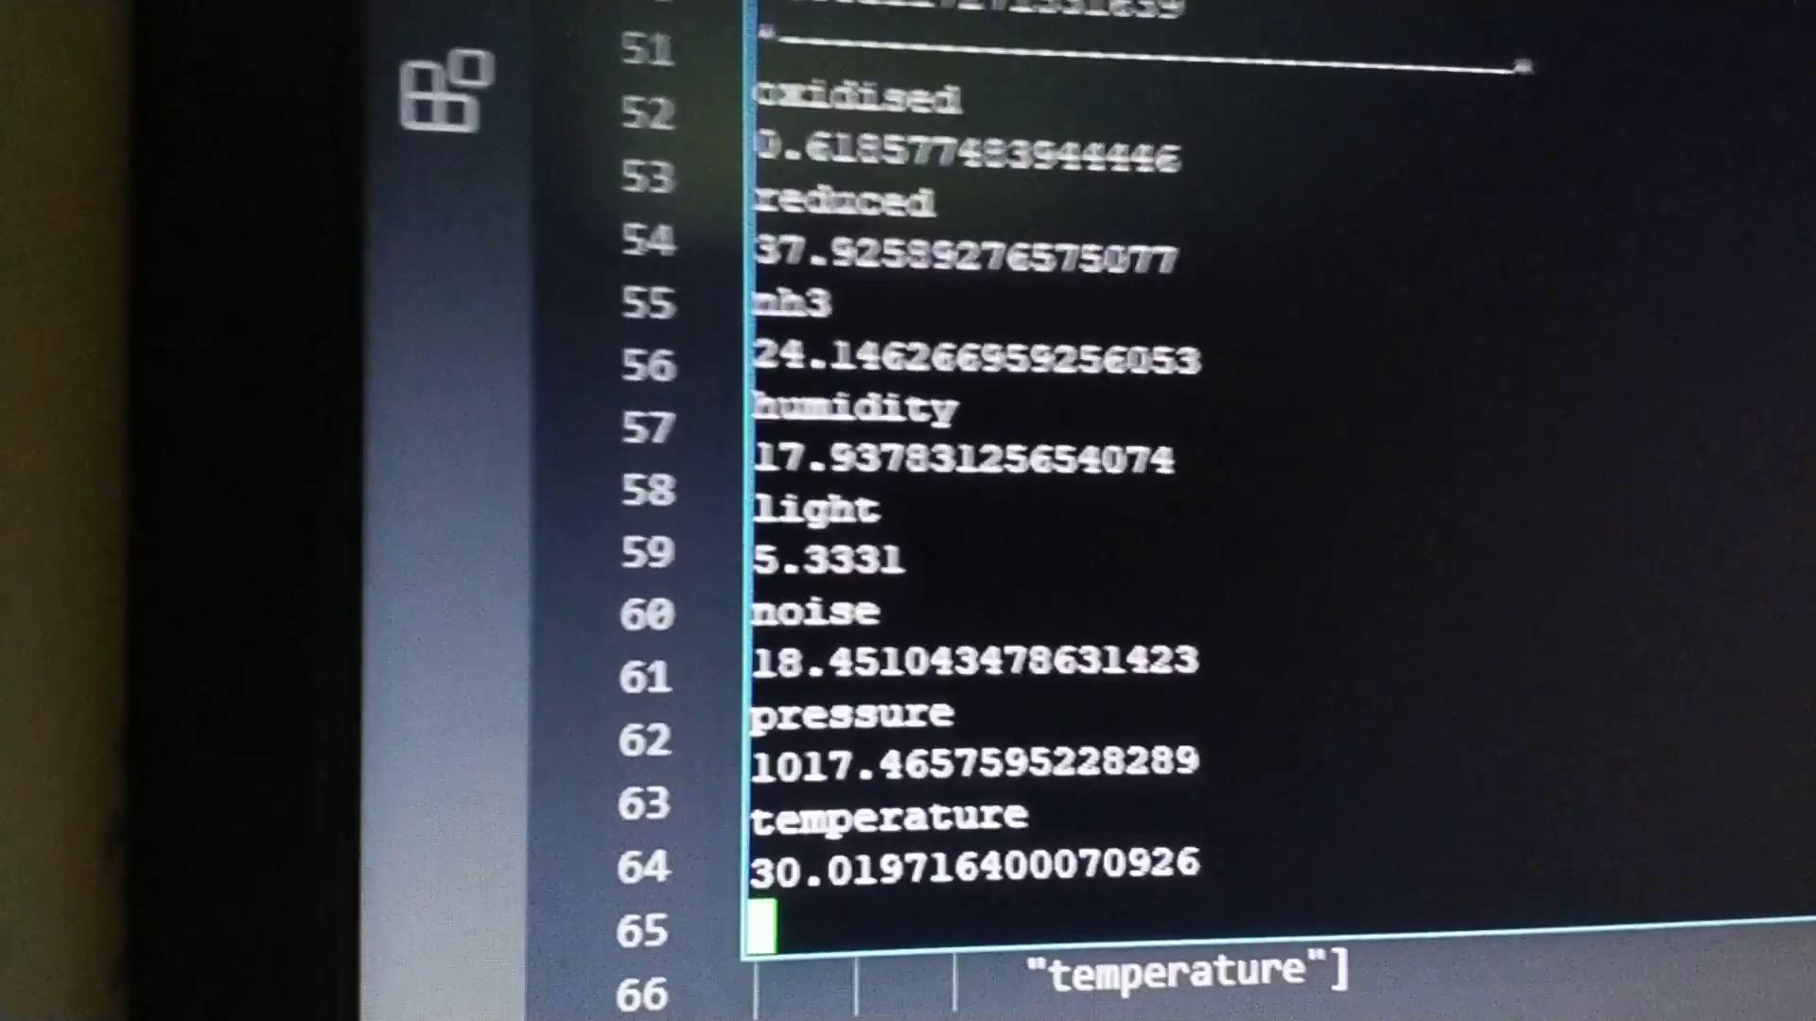
Sensor Data Subsystem: Test Report
- Functionality proven through proximity testing with known chemicals
- Temperature data offset by heatsink proximity to sensors
- Pressure and gas readouts cross referenced with known values around the world
- Light tested with torch and blackout
- Spoken audio test

Slide 18

Sensor Data Subsystem: Conclusion
Lessons learned:
Don’t always rely on user sourced libraries
Sometimes better to write your own drivers from scratch
Further work includes:
Defining noise levels in dBu / dBFS
Integration: module __init.py__ placement (file hierarchy)

Slide 19
Oliver Campbell
James Arnold
Image Processing and Target Detection - Mechatronics Engineering - Final Year
Image Processing and Target Detection - Software and Computer Science Engineering - Final Year
Notes:
My name is Oliver Campbell, I study mechatronics engineering and am in my final year, and with me is James Arnold, *talk talk talk*, and together we were responsible for the image processing and target detection subsystem for this project. This subsystem is mainly defined by high level objective 2 - target identification. So our subsystem was responsible for detecting the targets as specified by the client, and communicating this to the ground control system.

Slide 20
Image Processing Introduction
System Requirements
REQ-M-3/HLO-M-1: The UAVPayload^{TAQ} shall communicate with a ground station computer to transmit video, target detection and air quality data.
REQ-M-4/HLO-M-2/HLO-M-3: The target identification system shall be capable of alerting the GCS of a targets type.
REQ-M-6/HLO-M-3: The Web Interface is required to display the images of the targets that are taken directly from the UAVPayload^{TAQ} and updated every time a new picture is taken.
REQ-M-12/HLO-M-2/HLO-M-3: The UAVPayload^{TAQ} shall process all imagery on-board via the on-board computer.
REQ-M-13/HLO-M-2/HLO-M-3: The processing must be able to analyse all data from the flight path while the UAV moves at a maximum speed of 1m/s.
REQ-M-14/HLO-M-2/HLO-M-3: The processing must be able to analyse all data from the flight path while the UAV operates at an altitude of 2m.
Work Packet Structure
WP-IMG-1 - Image Capture and Research
WP-IMG-2 - Define Training Dataset
WP-IMG-3 - Model Definition
WP-IMG-4 - Train Machine Learning Model
WP-IMG-5 - Unit Testing
Notes:
The image processing system related to a large amount of the system requirements.
Requirement 3

Slide 21
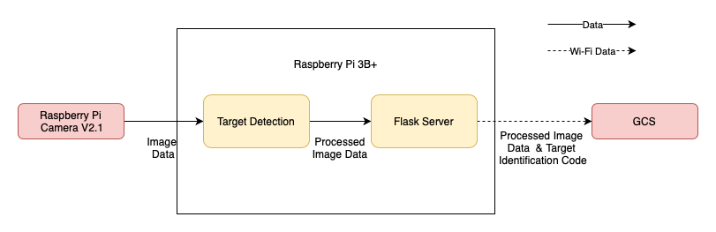
Subsystem Architecture

Slide 22
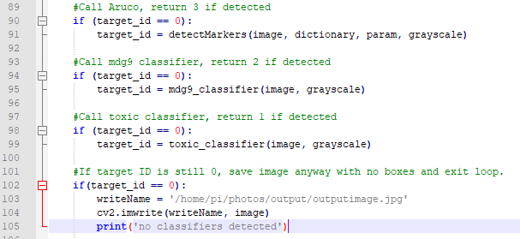
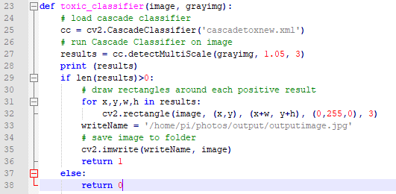
Code Design
https://youtu.be/31DP3ibHnpg?t=143

Slide 23
Cascade Classifier Training
Training Parameters:
# of positive images, # of negative images
# of stages
minhitrate, maxfalsealarm
Final Parameters:
850 pos images, 150 neg images, 6 stages, 0.3 hit rate, 0.1 false alarm
Images at 100x100 resolution with target overlayed if positive
Ensure samples contain target in every orientation

Slide 24
Cascade Classifier Testing
Print each target out to an A4 sheet
Capture images at distances of 0.5, 1 and 2m.
Orientate target in a variety of ways
Record number of correct detections, false positives and missed detections
Change one parameter at a time to minimise variables.

Slide 25
Conclusion
Could have had a more objective testing process (e.g. target >90% success rate and <10% false positive)
Could have tested other machine learning with additional time.
Overall, successfully met customer requirements and satisfied with performance.

Slide 26
Brian Sivertsen
Web Visualisation - Software and Computer Science Engineering - Final Year

Slide 27
Web Visualisation Introduction
System Requirements:
REQ-M-3: The UAVPayload^{TAQ} shall communicate with a ground station computer to transmit video, target detection and air quality data.
REQ-M-4: The target identification system shall be capable of alerting the GCS of a targets type.
REQ-M-5: The Web Interface is required to display real time air sampling data that is recorded directly from the UAVPayload^{TAQ} and updated dynamically throughout the duration of the flight.
REQ-M-6: The Web Interface is required to display the images of the targets that are taken directly from the UAVPayload^{TAQ} and updated every time a new picture is taken.
REQ-M-7: The Web Interface shall be designed and run as a web server, which is to be accessible by any computers on the local network.
REQ-M-15: Live data from the UAV must be made available through the web server within 10 seconds of capture.
Work Packets:
WP-WEB-1: Feasibility Research
WP-WEB-2: Backend Preliminary Design
WP-WEB-3: Front End Preliminary Design
WP-WEB-4: Subsystem Development
WP-WEB-5: Integration Testing

Slide 28
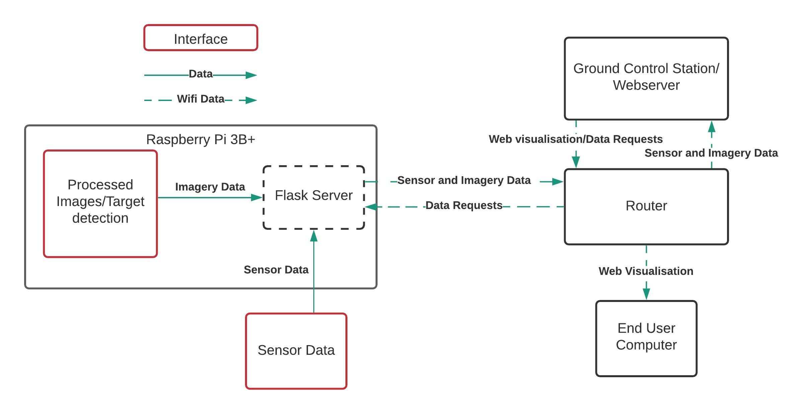
Web Subsystem Architecture

Slide 29
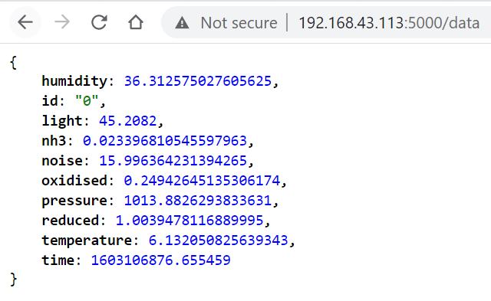
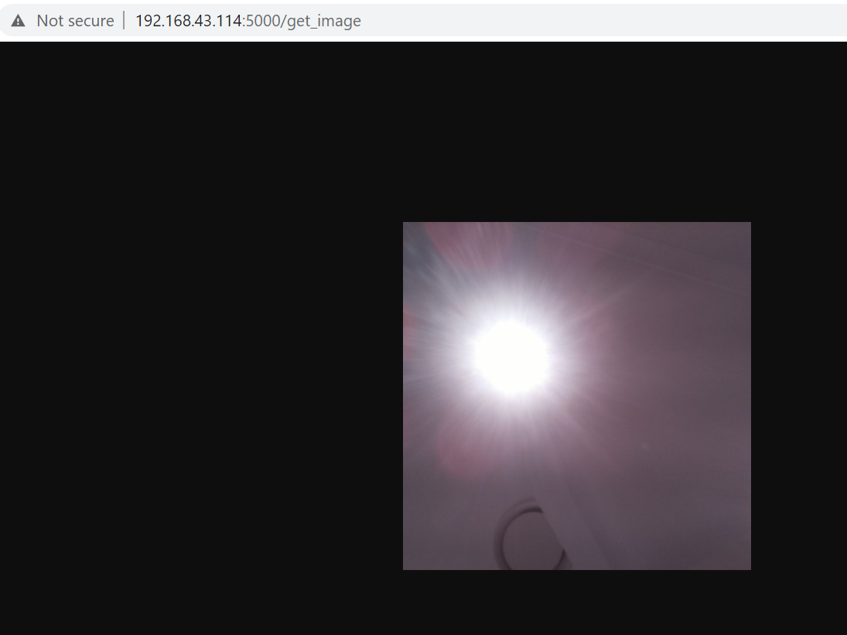
Back End Server Design
#Import packages above
import sys
sys.path.insert(1, '/home/pi/enviroplus/examples')
import dataSense
app = Flask(__name__)
@app.route('/data')
def get_current_data():
d = dataSense.returnSensors()
id = open("/home/pi/pythonscripts/detectionFile.txt", "r")
d["id"] = id.read()
return jsonify(d)
@app.route('/get_image')
def get_image():
return send_file('/home/pi/photos/output/outputimage.jpg')

Slide 30
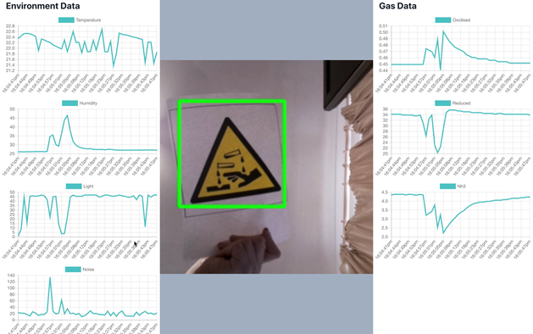
Front End Design
useEffect(() => {
fetch('/data').then(res => res.json()).then(data => {
data.time2=Date.now();
setData(data);
let newGraphs = graphs;
if (graphs.length < 50)
newGraphs.push(data);
else {
newGraphs.shift()
newGraphs.push(data);
}
if (data.id == "1"){
let toxic = new Audio("./toxic.ogg")
toxic.play();
} else if ( data.id == "2"){
let dangerous = new Audio("./dangerous.ogg")
dangerous.play();
} else if ( data.id == "3"){
let aruco = new Audio("./aruco.ogg")
aruco.play();
}
setGraphs(newGraphs);
});
});
<Image width="40%" height="100vh" src={`/get_image?${data.time2}`} />

Slide 31
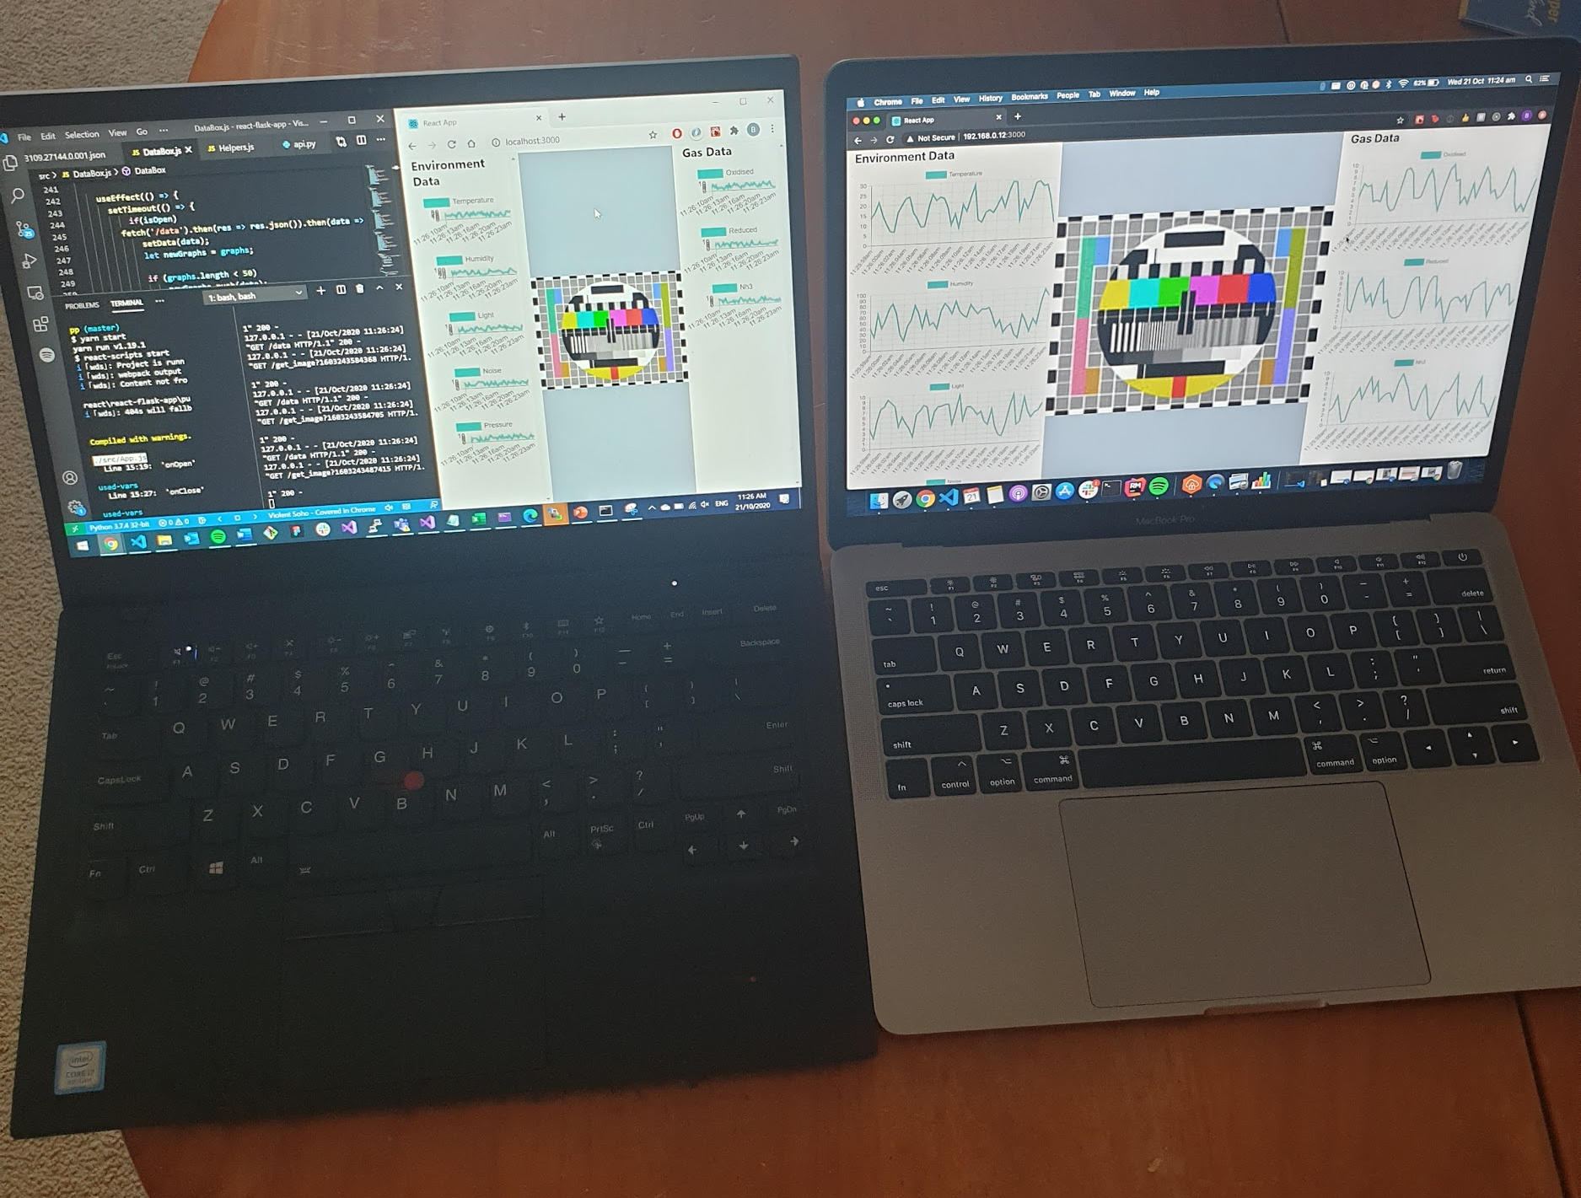
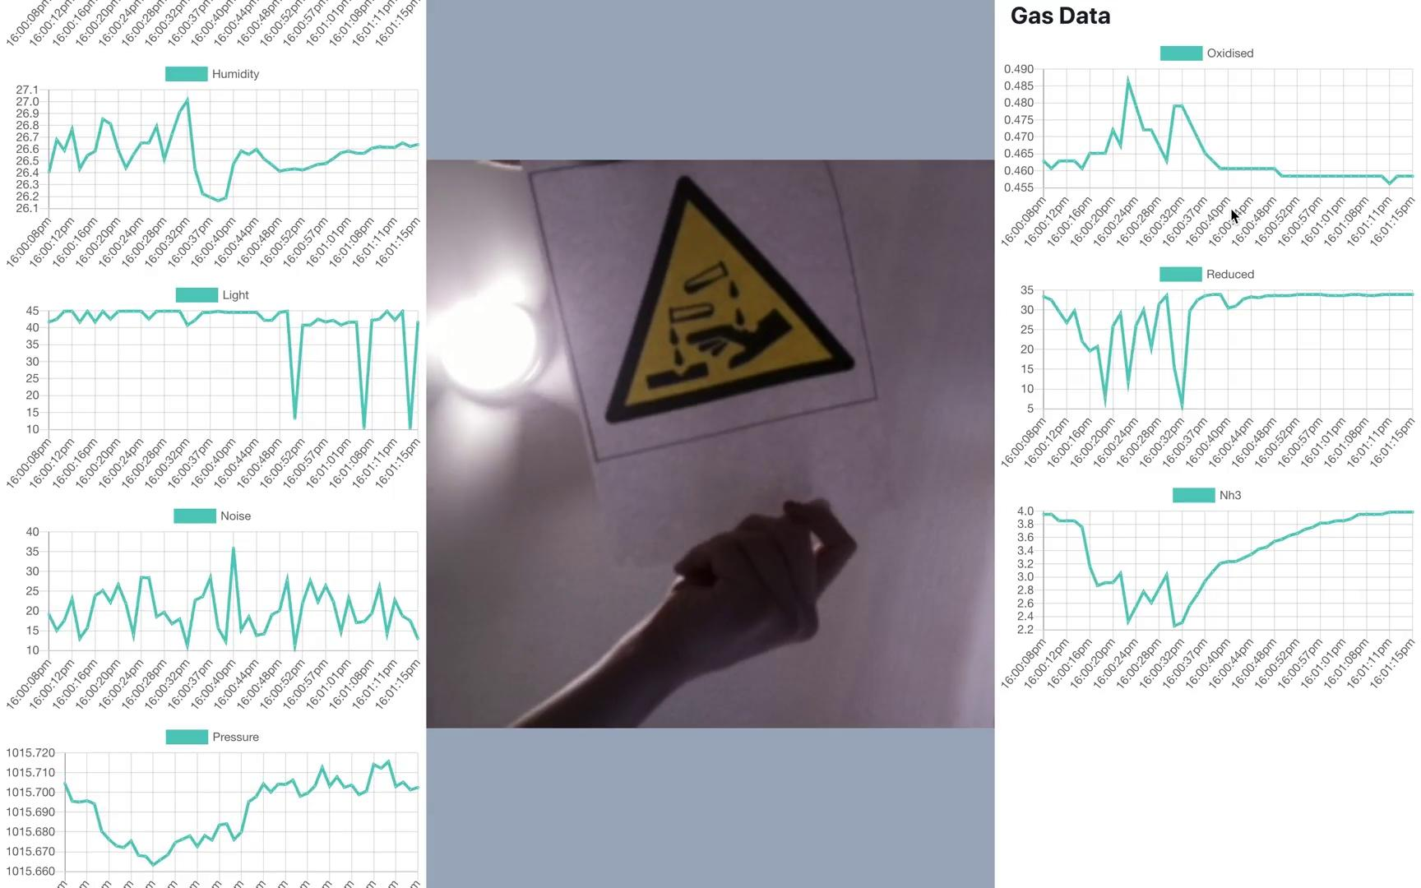
Pre-Integration Testing
REQ-M-7: WEB subsystem runs as web server and is available over LAN:
REQ-M-4: Target identification should be capable of alerting GCS of targets type:

Slide 32
Post-Integration Testing
REQ-M-3: The UAVPayload^{TAQ} shall communicate with a ground station computer to transmit video, target detection and air quality data:
REQ-M-5: The Web Interface is required to display real time air sampling data that is recorded directly from the UAVPayload^{TAQ} and updated dynamically throughout the duration of the flight: Video
REQ-M-3: The Web Interface is required to display the images of the targets that are taken directly from the UAVPayload^{TAQ} and updated every time a new picture is taken: Video
REQ-M-15: Live data from the UAV must be made available through the web server within 10 seconds of capture: Video

Slide 33
WEB Subsystem Conclusion

Slide 34
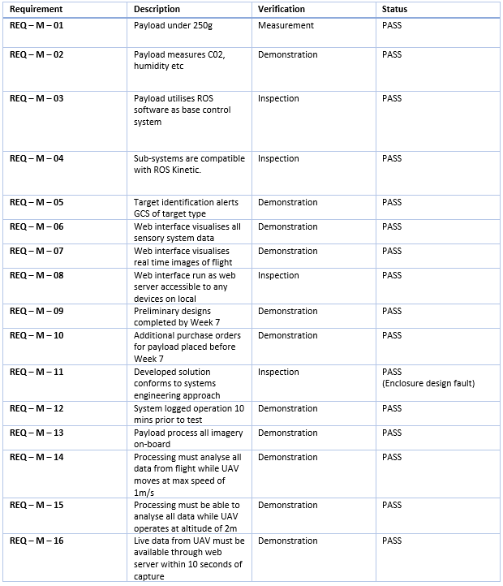
Verification and
Validation Table
The physical, functional and performance requirements were met.
User requirements were partially met as enclosure had a design fault which complicated the mounting process to UAV.

Slide 35
Conclusions/Lessons Learned
The project/customer requirements were met and even exceeded in some areas.
However, improvements can be made to all respective areas of project to optimise results.
The enclosure could have been more robustly and intuitively designed for the demonstration.
The group performed well together as a collaborative unit.
Every member was resourceful and incredibly reliable.
Overall progress was achieved through meeting deadlines, great communication, frequent meetings and discussions.

Slide 36
Questions?

